Slide 1
Use of KSKelvin Subckt Symbol from Autogenerated Model
KSKelvin Kelvin Leung
8-3-2024

Slide 2
Introduction
Purpose
This guideline show step-by-step instruction to use Subcircuit Symbol from KSKelvin Symbol Library for Autogenerated Model in Qspice
Focus on subcircuit (.subckt) model of X-device
Device model from Texas Instrument OPA462 is used for this demonstration
Website : https://www.ti.com/product/OPA462
Description : OPA462, 180-V, wide bandwidth (6.5 MHz), high-slew rate (25 V/µs) unity-gain stable op amp
OPA462 Pspice Model (Rev. D) : https://www.ti.com/lit/zip/sbomav9
Prerequisite
Knowledge of X-device (subcircuit / .subckt) and method of Auto-generate Symbol in Qspice
Reader can learn importing model and subcircuit from following reference
Importing 3rd Party Models into Qspice by Mike Engelhardt : https://www.qorvo.com/design-hub/design-tools/interactive/qspice#videos
General Reference Guideline in KSKelvin’s Github : https://github.com/KSKelvin-Github/Qspice/tree/main/Guideline

Slide 3
Preparation

Slide 4
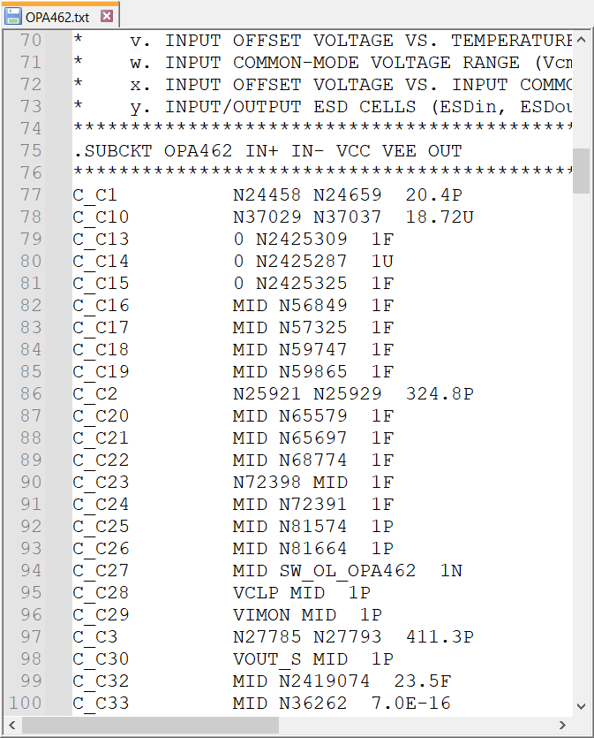
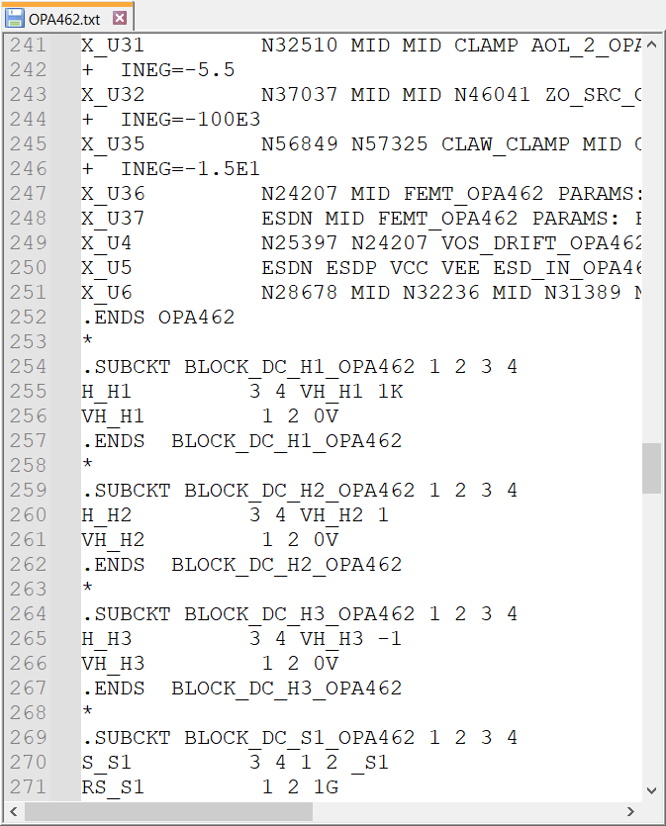
Use KSKelvin Subckt Symbol from Autogenerated Model
Step 1 : Model Study
In general, model is named as .lib, .txt, .mod or .sub etc…
Use text editor to open and inspect the model
Only unencrypted model can be used for auto generate symbol in Qspice
[1] Identify the .subckt of device (in this example, OPA462), and confirm its pin sequence
[2] Verify if this subcircuit has dependent .subckt. If X-device can be found between .subckt and .ends, this device will call other subcircuit
[1]
[2]
other subcircuit

